Slide 1

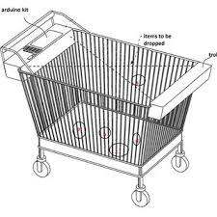
PCET’s Pimpri Chinchwad College of Engineering and Research, Ravet
Automatic Shopping Cart With Advanced Billing System
Group Members :
Niranjani Wagh
Shraddha Waphare
Rachana Patil
Shrutika Phalke
Guided By :
Prof. Jameer Kotwal

Slide 2
INTRODUCTION
The basic idea is to give a efficient shopping way to customers. The main purpose is to reduce the waiting hours for billing in malls. This can be achieved by automation and hence we are automating the shopping cart. This will include the automatic scanning of products and generation of lump sum amount.

Slide 3
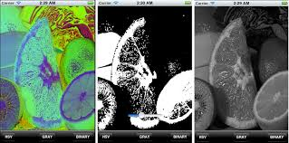
IMAGE PROCESSING
Image processing is a method to perform some operations on an image, in order to get an enhanced image or to extract some useful information from it. It is a type of signal processing in which input is an image and output may be image or characteristics/features associated with that image. Nowadays, image processing is among rapidly growing technologies. It forms core research area within engineering and computer science disciplines too.

Slide 4
IMAGE PROCESSING
Image processing basically includes the following three steps:
Importing the image via image acquisition tools;
Analysing and manipulating the image;
Output in which result can be altered image or report that is based on image analysis.

Slide 5
SIFT
Matching features across different images in a common problem in computer vision. When all images are similar in nature (same scale, orientation, etc) simple corner detectors can work. But when you have images of different scales and rotations, you need to use the Scale Invariant Feature Transform.

Slide 7
MOTIVATION
The long queues in the shopping malls create impassiveness among the customers.
This may cause the reduction in the ROI (Return on investment).
Thus shopping malls are facing a lot of complications.
Due to this the working flow of the malls has to be changed. This is the main motivation behind this project.

Slide 8
LITERATURE SURVEY
Object Recognition in Shopping Cart
Authors :- Pradeep Gurunathan, Vishal Guruprasad, Ganveer N
Smart Shopping Cart For Automated Billing Purpose Using Wireless Sensor Networks
Authors :- Udita Gangwal, Sanchita Roy, Jyotsna Bapat
Smart Trolley In Mega Mall Authors :- J. S. Awati, S. B. Awati

Slide 9
GOALS AND OBJECTIVES
To reduce the time of scanning the products by replacing the scanner to image processing techniques.
To reduce the long queues by implementing the SIFT algorithm.
To increase the overall revenue of the shopping malls by increasing the ROI.

Slide 10
SOFTWARE AND HARDWARE REQUIREMENTS
Sr. No. | Parameter | Minimum Requirement
1 | CPU Speed | 2 GHz
2 | RAM | 3 GB
3 | Rasp Pi | 1 GB
Operating System: Windows
IDE: OpenCV
Programming Language: Python

Slide 11
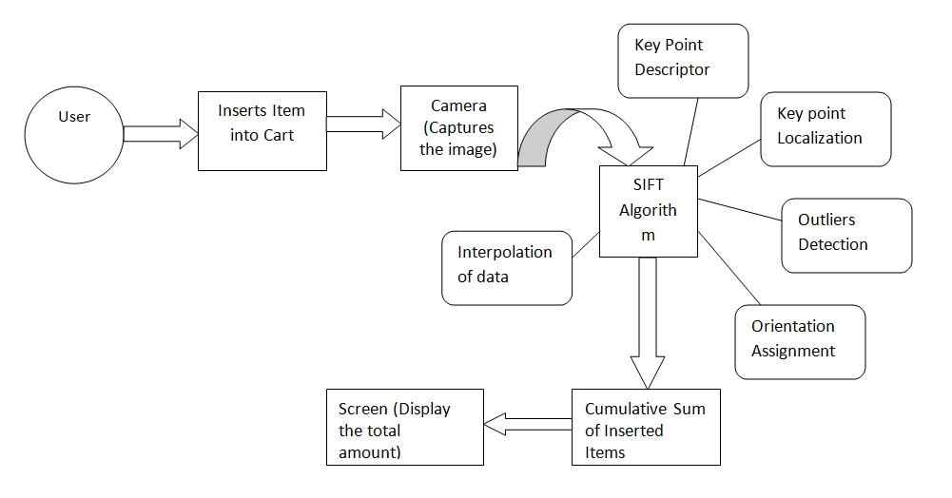
SYSTEM ARCHITECHTURE

Slide 12
PROPOSED SYSTEM
Whenever user puts a product into the cart, the camera will capture the images. These images are compared with the images present in the database using SIFT algorithm.
Once the images are matched, the correct product will be recognized and the corresponding amount will be displayed on the screen.
If the user removes any product, images are captured again and compared with the database images.
After product recognition the respective amount is reduced from the total amount. The camera will not capture images of the products present in the vicinity of the cart.
The payment mode depends on the grocery store or shopping mall authorities.

Slide 13
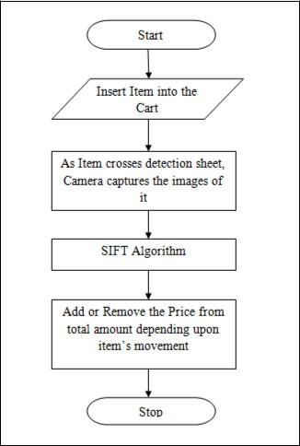
WORKING

Slide 14
WORKING
The user will insert the item into the cart.
As the item will cross the detection sheet , the camera will capture the image.
SIFT Algorithm will be implemented.
Addition and deletion of the item from the database will be depending on the movement of the item.
Subtotal of all the purchased items.

Slide 15
EXPECTED OUTPUT
The system should capture the images of the shopping items.
It should correspondingly add the prices of the purchased items in the subtotal.
The item should also be deleted from the total if the customer doesn’t wish to buy that item.
The subtotal of the purchased items should be displayed.

Slide 16
APPLICATION
The major application of automatic cart is in shopping malls. The main purpose is to reduce the time required to scan the products in the queue of billing.

Slide 17
FUTURE SCOPE
The proposed system does not make use of any intricate routing system model architecture instead it uses simple algorithm to banish existing problems.
This system can also be further extended to prevent the missing of RFID tag in one or more products.
It can be concluded that the initial cost of the system may be high but in subsequent years the system will be more beneficial when compared with the manual or barcode type of shopping system.

Slide 18
CONCLUSION
Thus, a system called Automatic Shopping Cart with Advanced Billing Sys-tem will be developed using SIFT algorithm, Image Processing, Machine Learning. As we have overcome the two measure problems of computational time and physical wastage of time thus, the time complexity is reduced. These problems were overcome by using the image capturing technique in the shopping cart itself. The computational time could be greatly reduced by using above technologies. In turn, the waiting time of the user will be reduced and the shopping experience will be enhanced.

Slide 19
THANK YOU

